Slide 1
Student Number – 25015126 Student Name – Aryan Bansal Shipping Dock Management System HD Assignment – 32606 Database – Spring 2023

Slide 2
ADANI Ports Shipping Dock Management System
Adani Ports is a multi-national Indian Port-operator and logistics company situated in Ahmedabad.
It is India’s largest integrated ports and logistics company which accounts to nearly one-fourth of the cargo movement in India.
The ports are present in 13 different places across India.
Adani Ports Website : https://www.adaniports.com/
This Database records the basic mechanism of what a port database can contain. It provides the reservation timings of shipment coming to the port and which all products are going to which warehouse and many more.

Slide 3
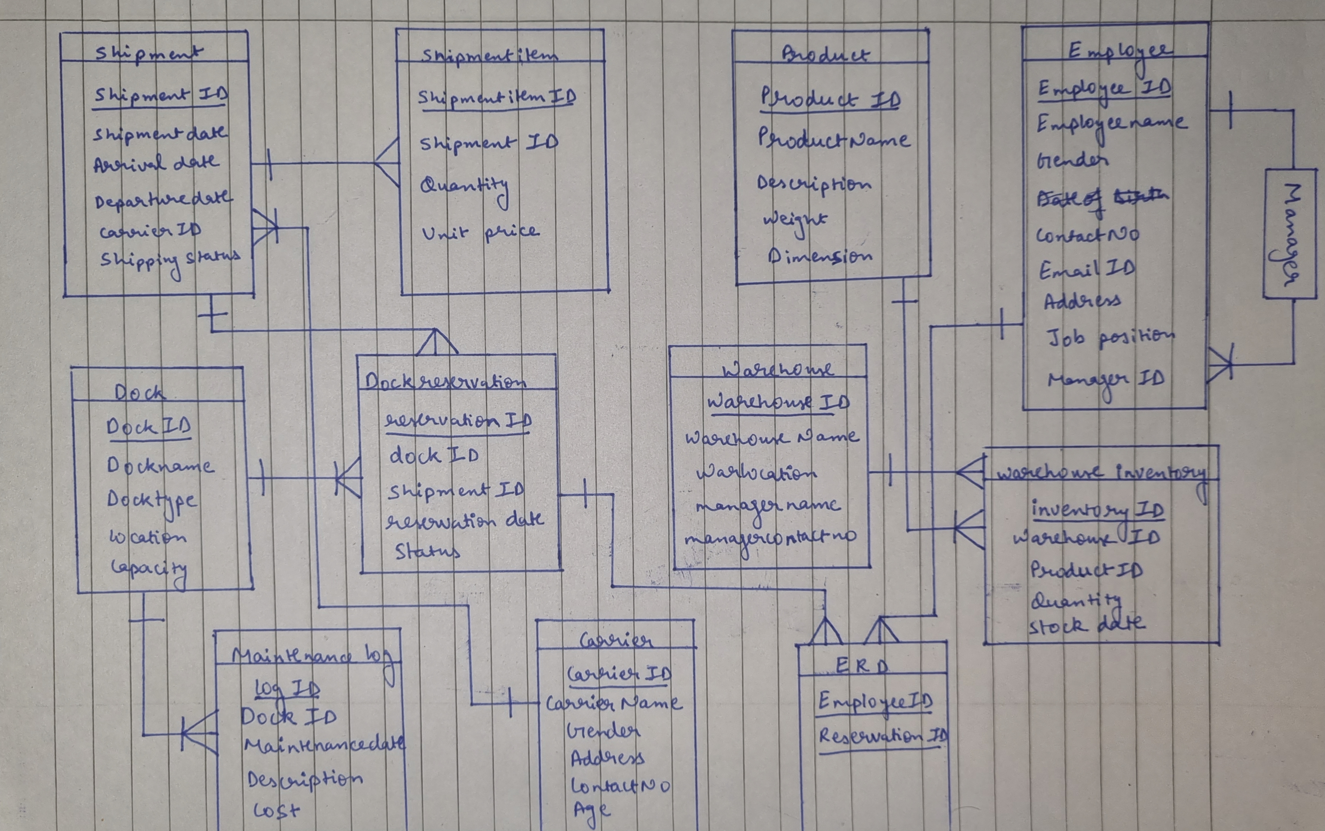
ERD Shipping Dock Management System

Slide 4
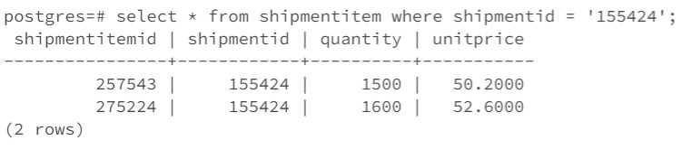
A single One-To-Many relationship between ShipmentID and ShipmentItemID
A single shipment can have many shipment items
Select * from shipmentitem where shipmentid = ‘155424’;

Slide 5
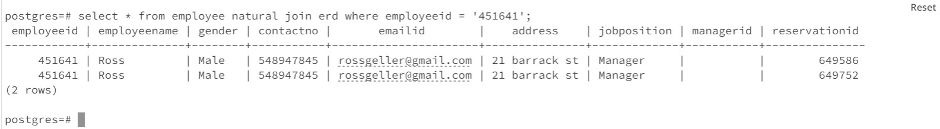
A single Many-To-Many Relationship
One Dock Reservation can be done by many employees and many dock reservations can be done by a single Employee
Select * from employee natural join erd where employeeid = ‘451641’;

Slide 6
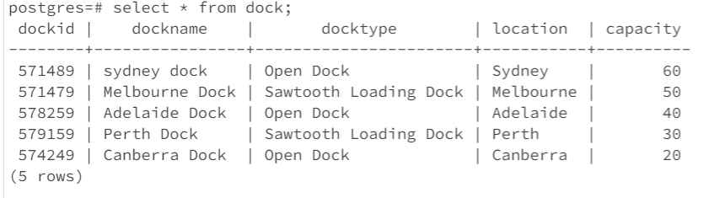
A simple Query of a single table
Lists the dock ID, Dock Name, Type of Dock, Location of Dock and its capacity
Select * from dock;

Slide 7
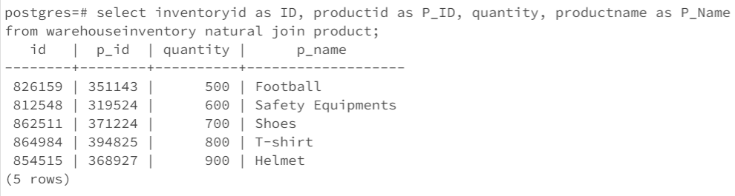
A Query which uses Natural Join
Listing Inventory id as ID, Product id as P_ID, Quantity and Product Name as P_Name by joining warehouse inventory and product tables using “Natural Join”
Select inventoryid as ID, productid as p_id, quantity, productname as P_name from warehouseinventory natural join product;

Slide 8
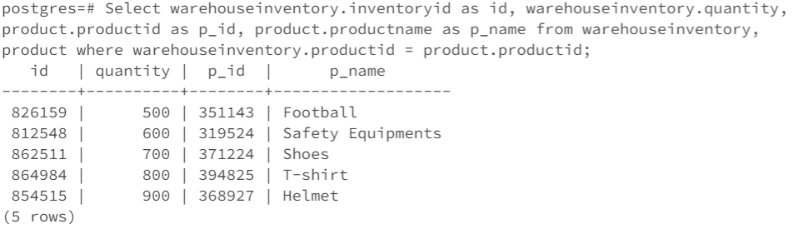
The Cross-product for the natural join above
This is the cross-product for the data extracted on the previous slide without using “natural join” or “cross join” or “inner join”.
Select warehouseinventory.inventoryid as id, warehouseinventory.quantity, product.productid as p_id, product.productname as p_name from warehouseinventory, product where warehouseinventory.productid = product.productid;

Slide 9
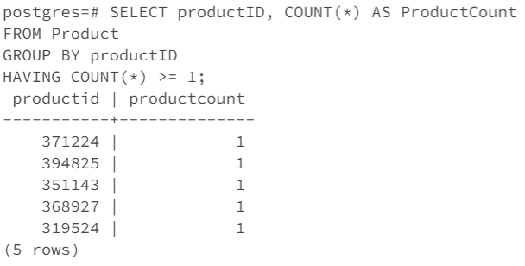
A Query Involving a “Group By” with “Having” Clause
Listing all the product id which are having product count of one or more. I’ve inserted only one product for every product id, that is why only one product count is showing for every product id
Select productid, count(*) as productcount from product group by productid having count(*) >= 1;

Slide 10
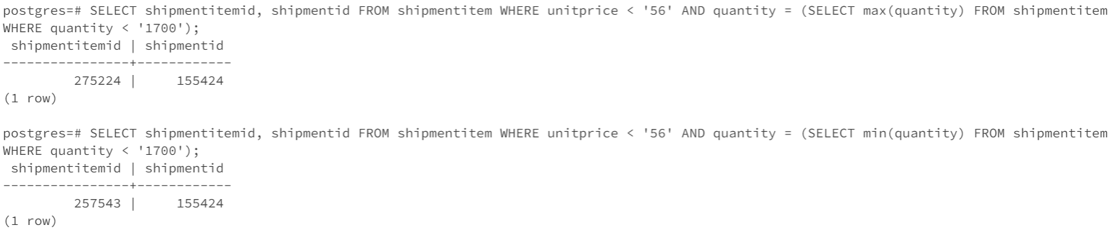
A Query which uses a sub Query
A query which finds max and min number of shipment item id where unit price is less than 56
SELECT shipmentitemid, shipmentid FROM shipmentitem WHERE unitprice < '56' AND quantity = (SELECT max(quantity) FROM shipmentitem WHERE quantity < '1700’);
SELECT shipmentitemid, shipmentid FROM shipmentitem WHERE unitprice < '56' AND quantity = (SELECT min(quantity) FROM shipmentitem WHERE quantity < '1700');

Slide 11
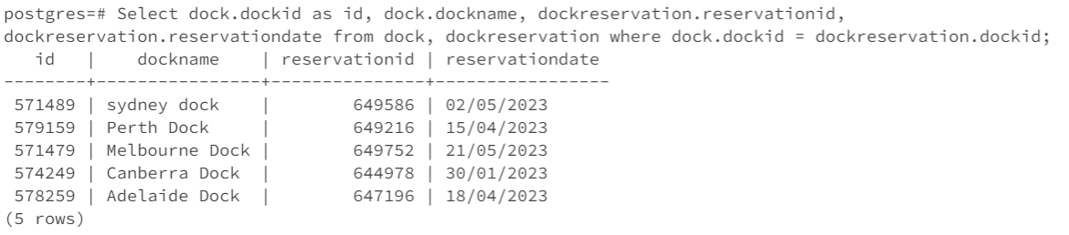
A cross product which cannot be implemented using the words “natural join”
A listing which shows dock name with its registration id and the date on which it was registered
Select dock.dockid as id, dock.dockname, dockreservation.reservationid, dockreservation.reservationdate from dock, dockreservation where dock.dockid = dockreservation.dockid;

Slide 12
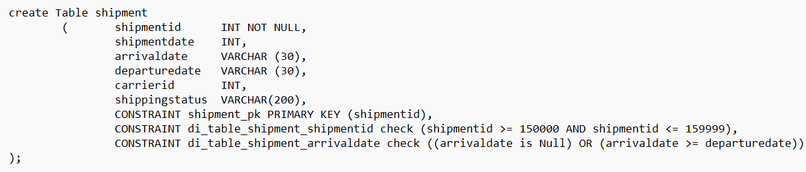
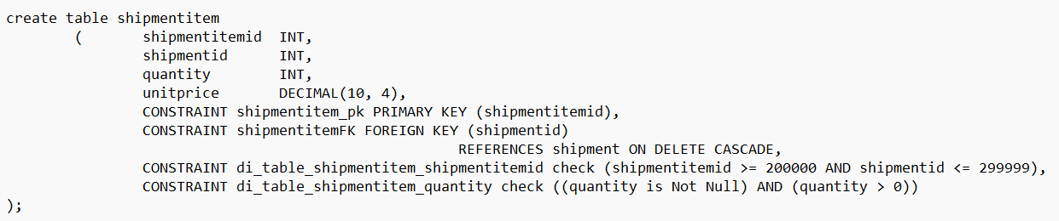
Check Statements

Slide 13
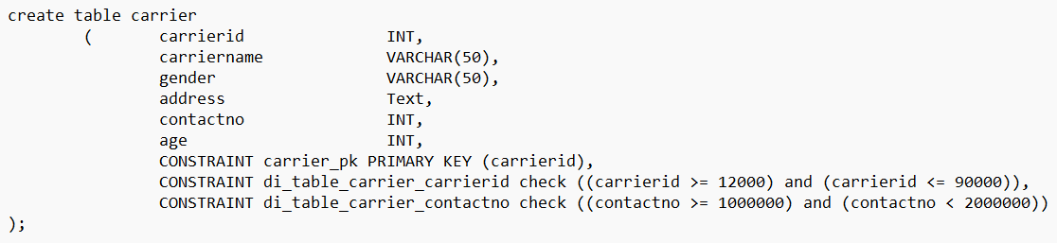
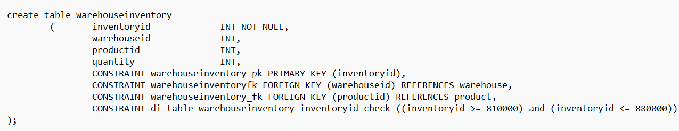
Check Statements

Slide 14
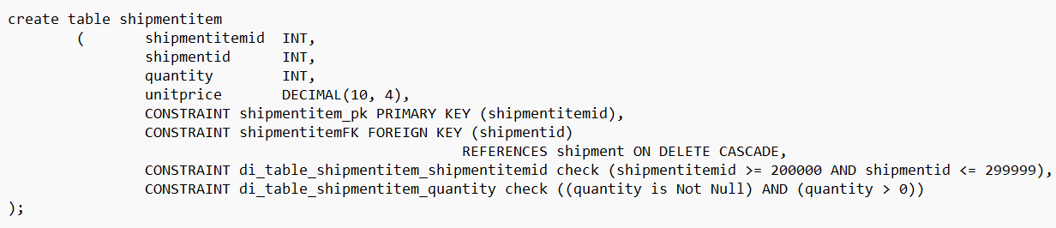
On Delete Cascade

Slide 15
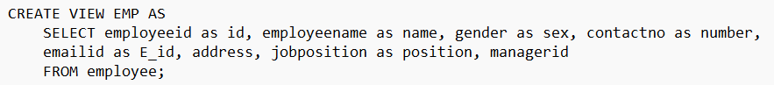
Create View

Slide 16
Thank You

